Slide 1

Implement a Serverless Data Analytics Strategy with Microsoft Azure
Roberto Freato – Azure MVP / CTO @Witailer

Slide 2
once upon a time
A business intelligence team performing analysis and getting out insights
An entire company depending on those insights
A small dev/tech team in charge to build data stuff to do it
We didn’t know how fast would grow up
Didn’t want to overengineer
Didn’t know what a Data Platform was, either
Can you read this line?

Slide 3
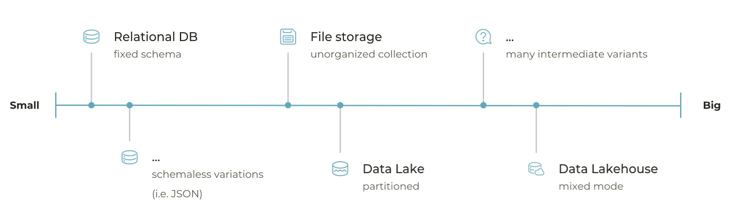
how we evolved and scaled the Data Platform
App Service
Batch
Container Instances
Container Apps
Even in the back seats?

Slide 4
some glossary
Data Movement
Data Platform
Landing Storage
Big Data
Spark
Sourcing
Ingestion layer
Data Engineering
Databricks
Cloud
And now?

Slide 6
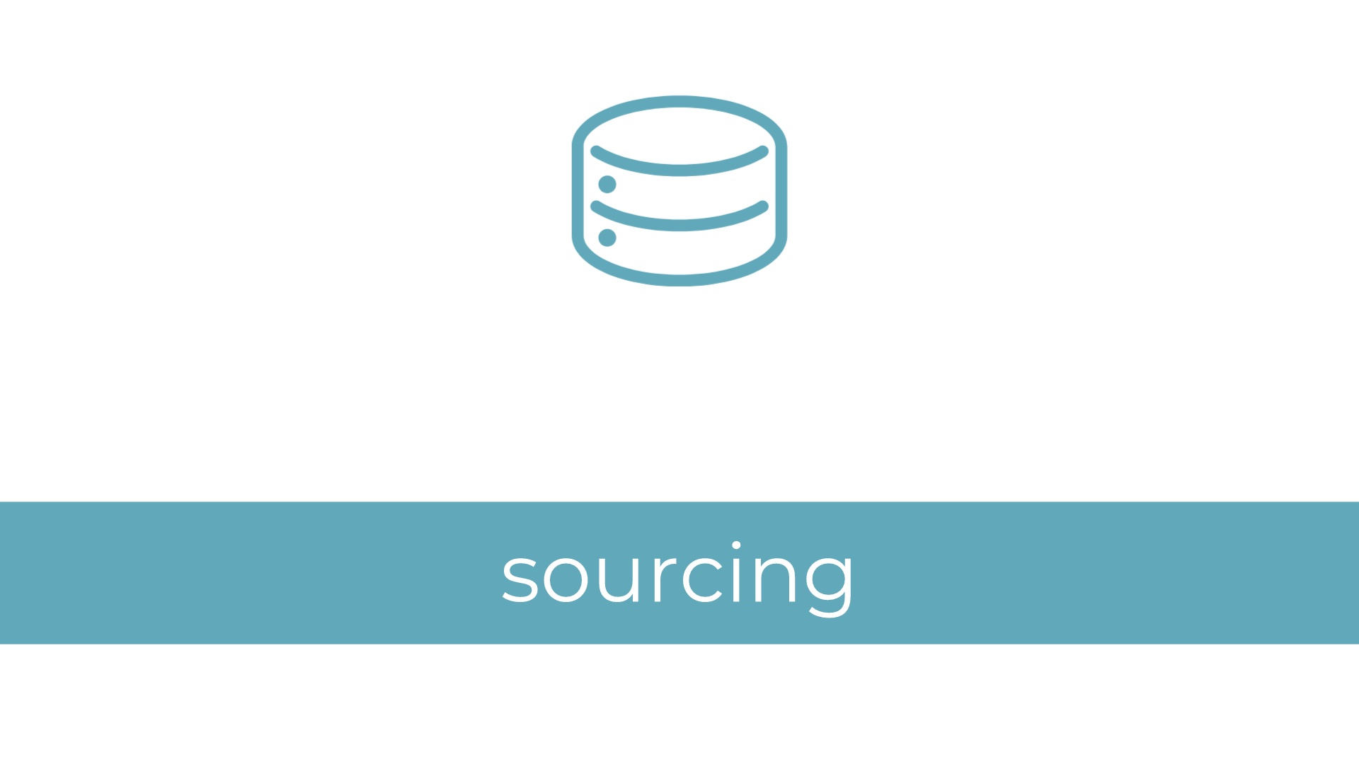

Slide 7
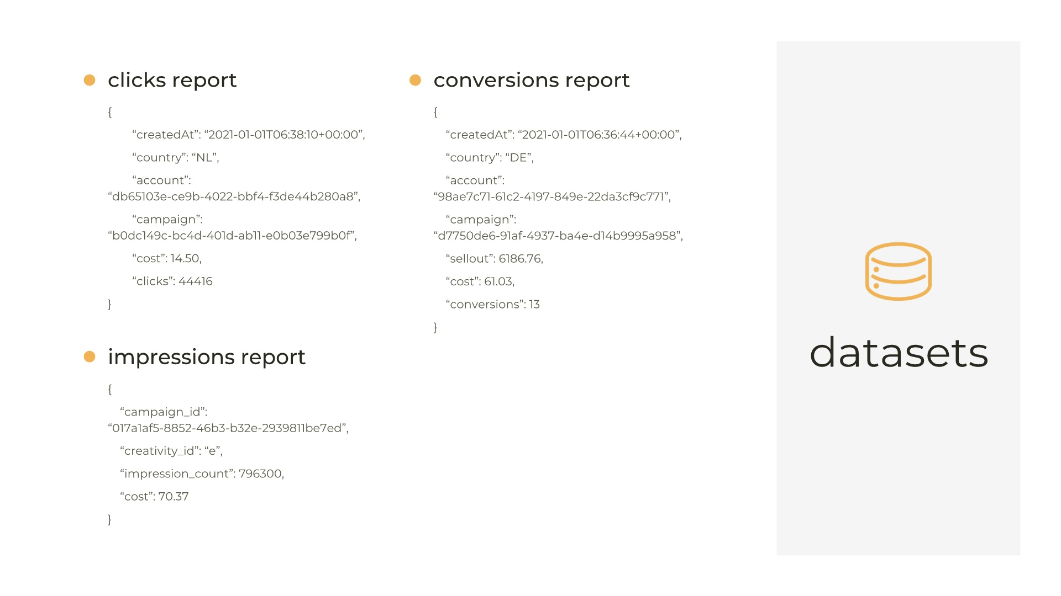

Slide 8
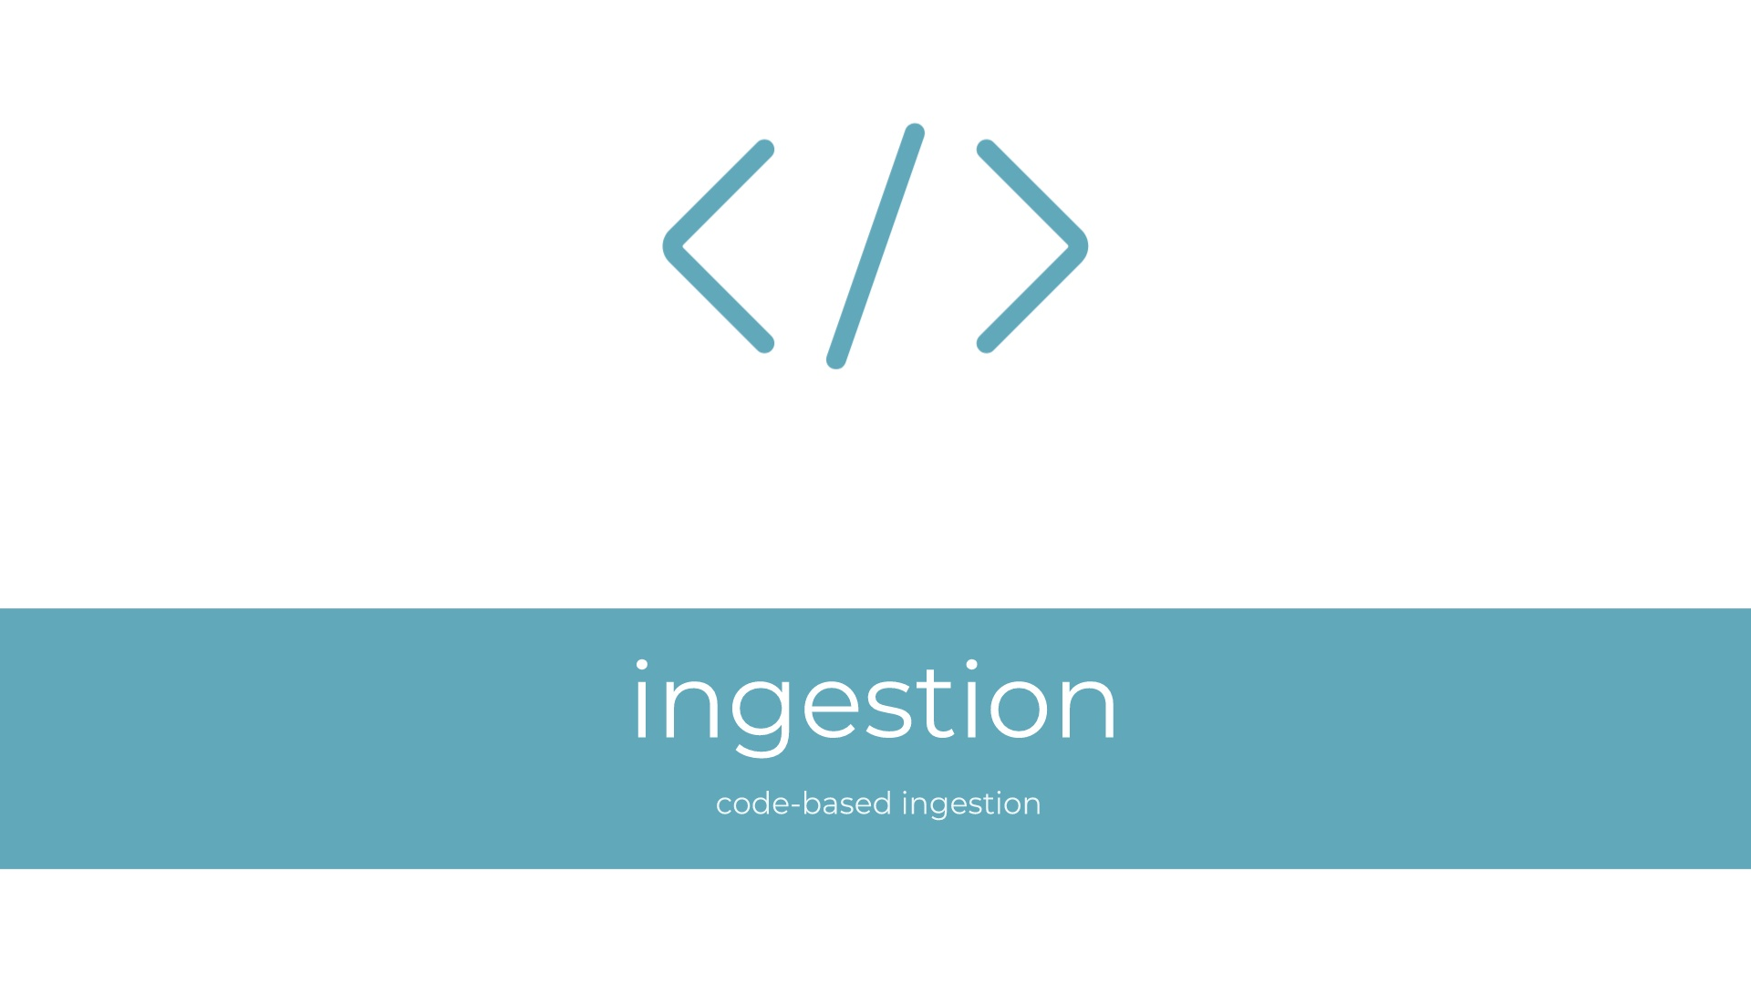

Slide 9
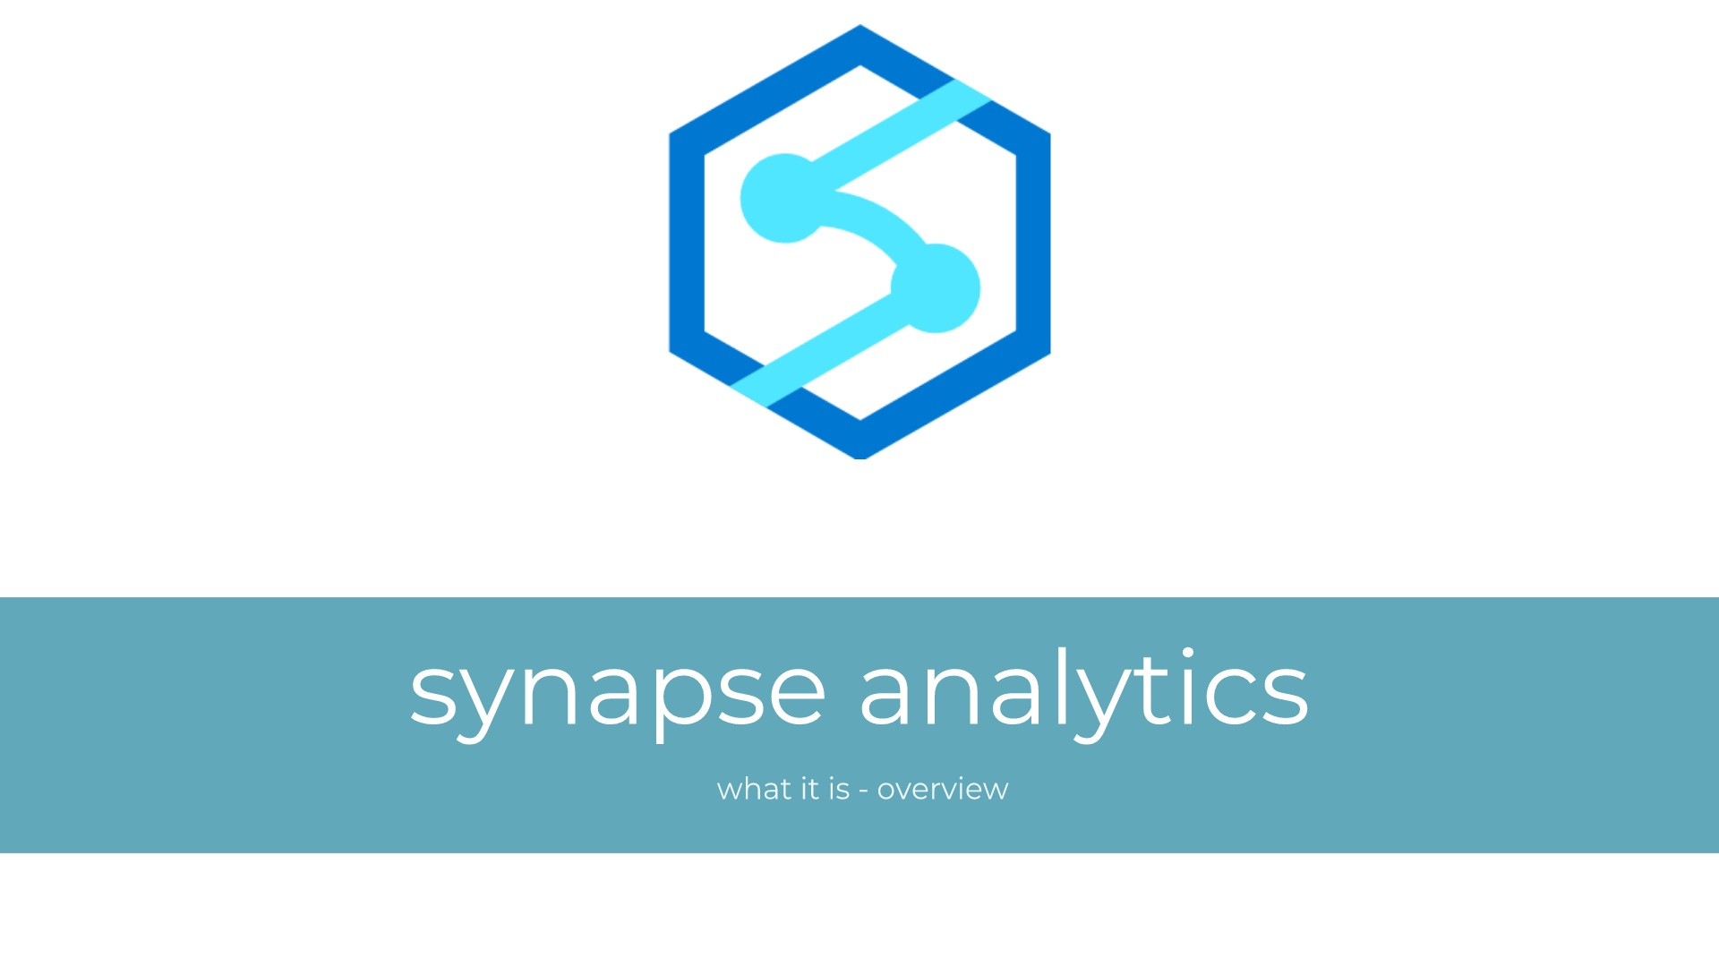

Slide 10
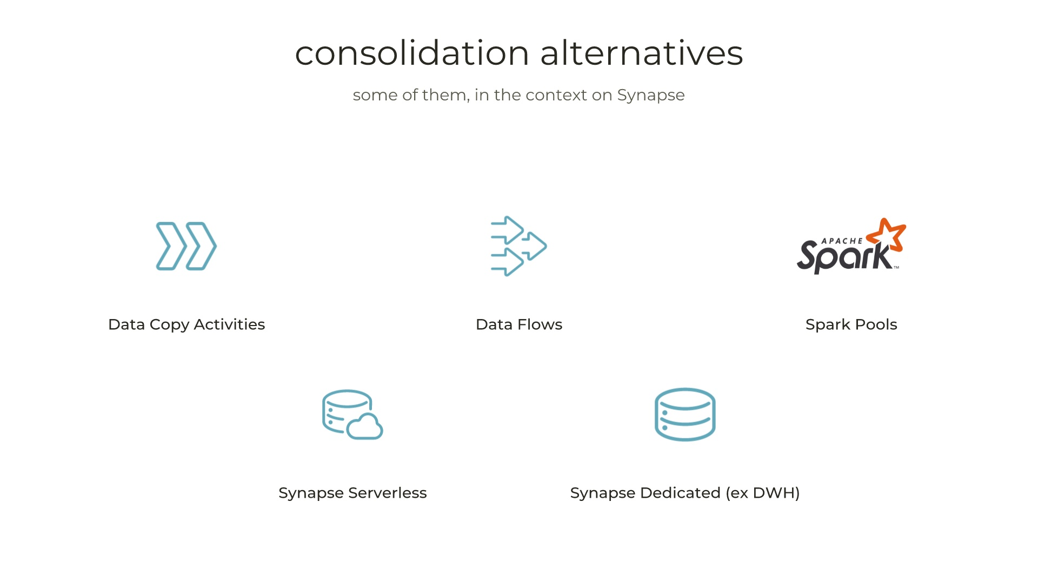

Slide 11
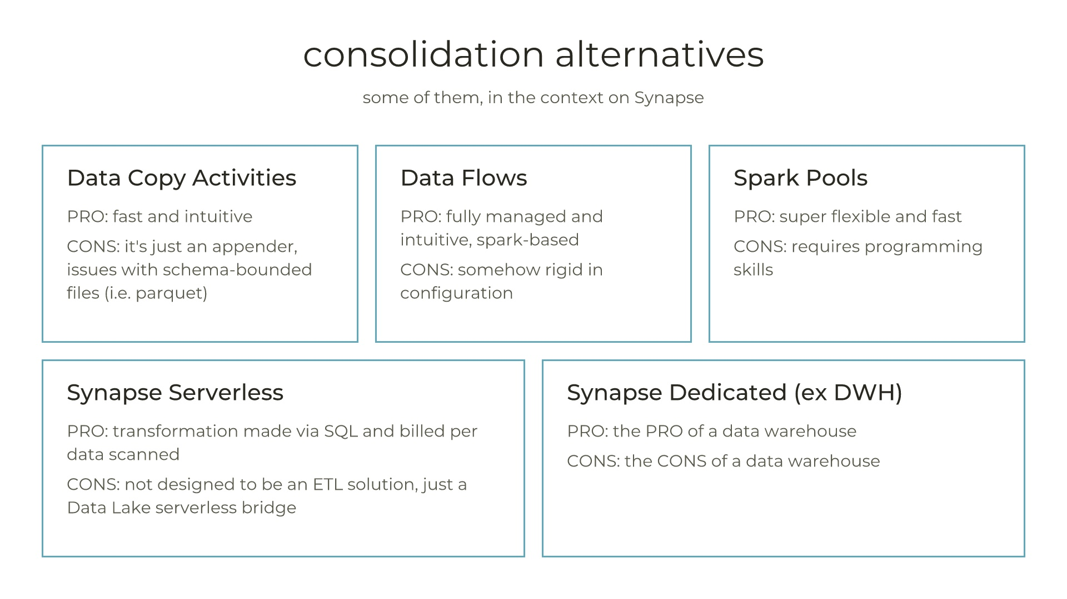

Slide 12


Slide 13
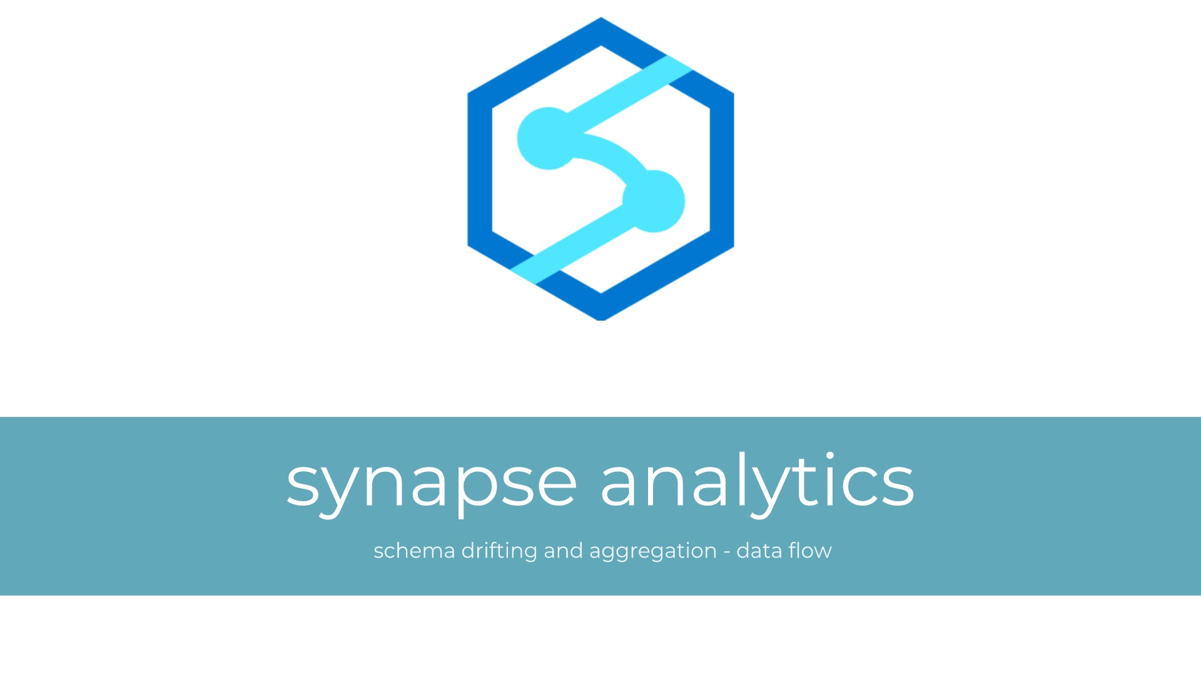

Slide 14


Slide 15
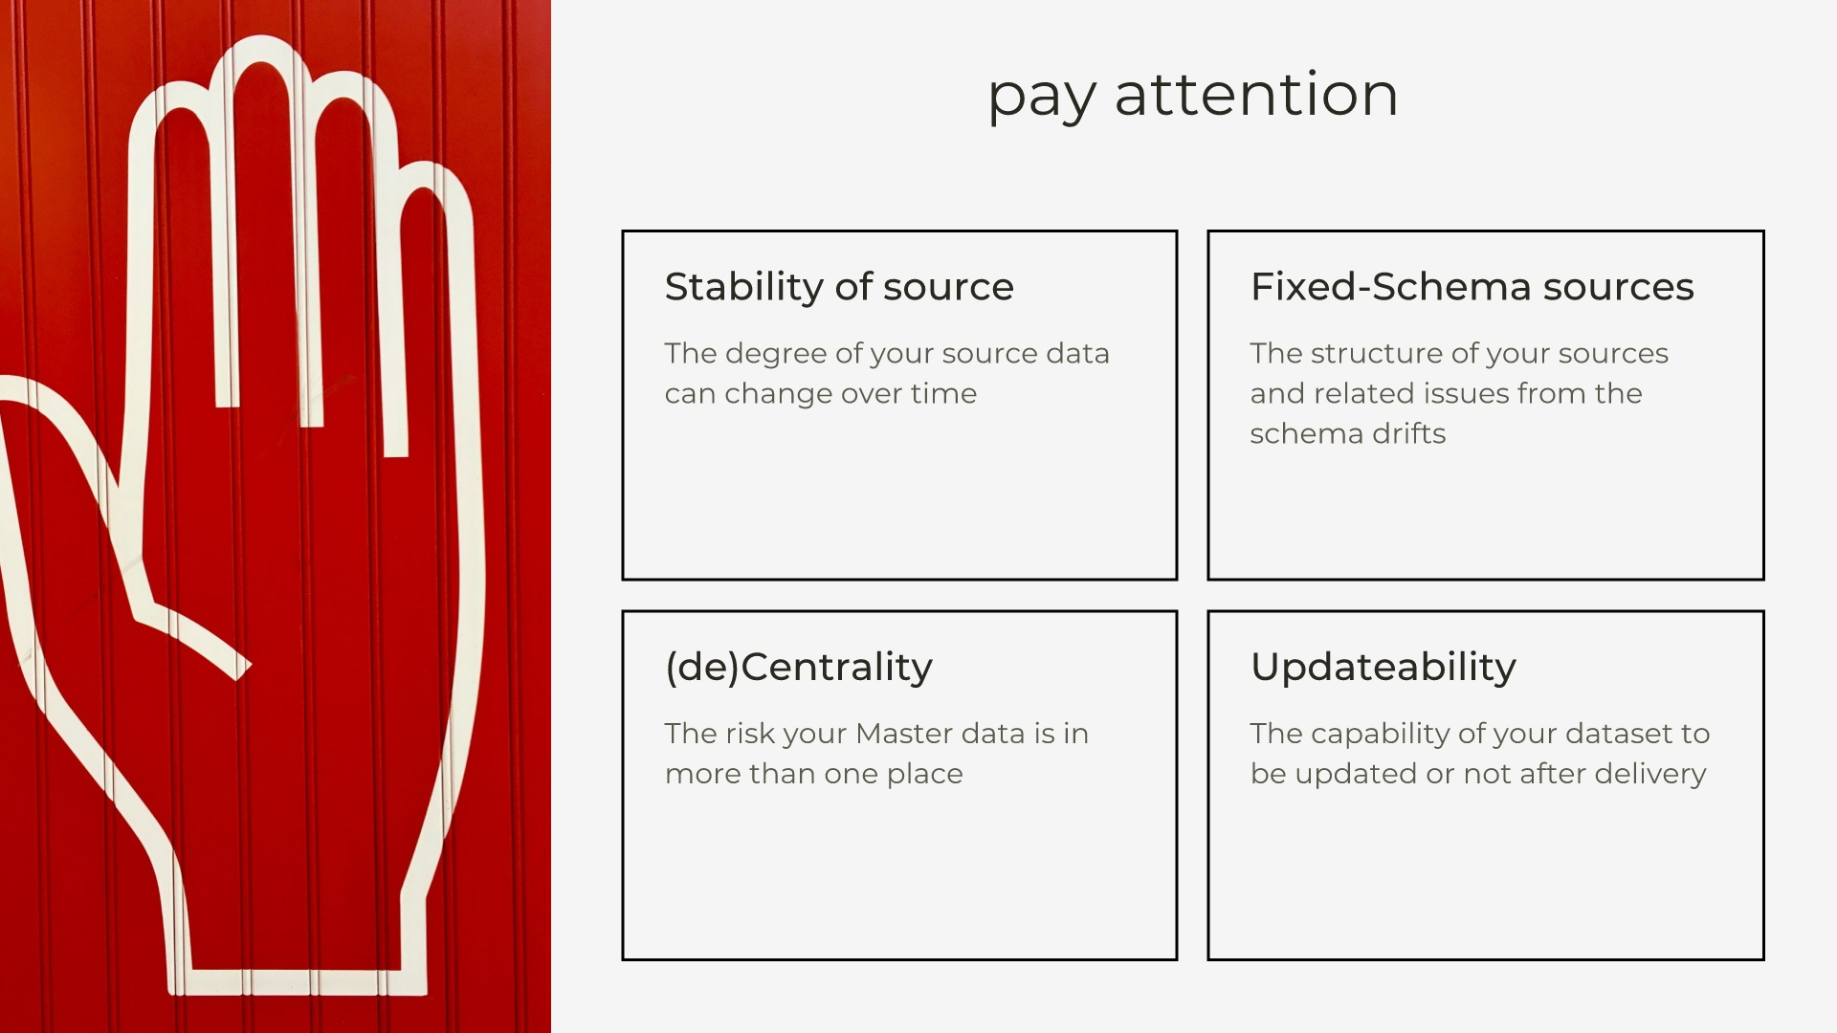

Slide 16
Thank you
Roberto Freato

